Slide 1
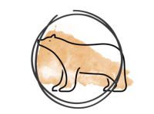
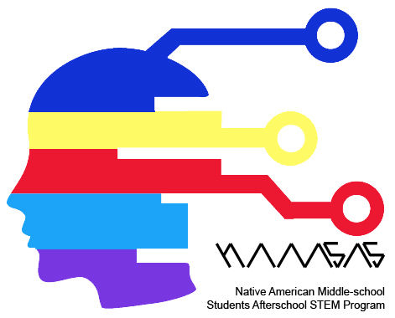
05 Fifth Fire: Augmented Living: Using AR in Design
Notes:
1st Fire
The Journey Begins - Leaving Our Coastal Home
Responding to the prophecy, the Neshnabek began a mass migration to the west. Guided by the sacred Megis shell of the Midewewin Lodge, the people gathered at a promised turtle-shaped island (Moniyak) near present day Montreal.
The Neshnabek continued their journey, following the Megis to a resting place at Kche Nisajewen (Niagara Falls). It was here that three related but distinct groups formed, the Ojibwe, Odawa and Bodéwadmi. Joined through heritage and spirituality, each group served the Neshnabek as a whole.
the Neshnabel will follow the sacred shell the Megis...to the chosen ground (see homeland You will know..he chosen ground... when you come to a land where food grows on water. If you do not move you will be destroyed
Mshike (Turtle)
The turtle is a revered spint, playing a role in ceremonies and our creation story. Here he symbolizes the beginning and end of our migration

Slide 2


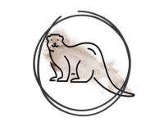
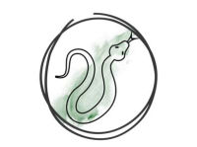
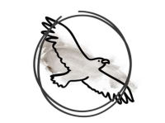
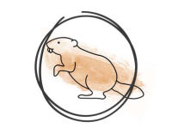
Third Fire: Finding a path to the chosen ground
First Fire: Looking for the turtle shaped island
Fifth Fire: A new way, from old teachings
Second Fire: Second Fire: Losing the shell and finding of the future pathway
Fourth Fire: New knowledge translated into physicality
Seventh Fire: In the time of the Seventh Fire New People will emerge. They will retrace their steps to find what was left by the trail
Sixth Fire: Honoring and venerating Elders
Notes:
1st Fire
The Journey Begins - Leaving Our Coastal Home
Responding to the prophecy, the Neshnabek began a mass migration to the west. Guided by the sacred Megis shell of the Midewewin Lodge, the people gathered at a promised turtle-shaped island (Moniyak) near present day Montreal.
The Neshnabek continued their journey, following the Megis to a resting place at Kche Nisajewen (Niagara Falls). It was here that three related but distinct groups formed, the Ojibwe, Odawa and Bodéwadmi. Joined through heritage and spirituality, each group served the Neshnabek as a whole.
the Neshnabel will follow the sacred shell the Megis...to the chosen ground (see homeland You will know..he chosen ground... when you come to a land where food grows on water. If you do not move you will be destroyed
Mshike (Turtle)
The turtle is a revered spint, playing a role in ceremonies and our creation story. Here he symbolizes the beginning and end of our migration

Slide 3

Product Designer

Slide 4

Industrial Engineer

Slide 5

Human Factors Engineer

Slide 6
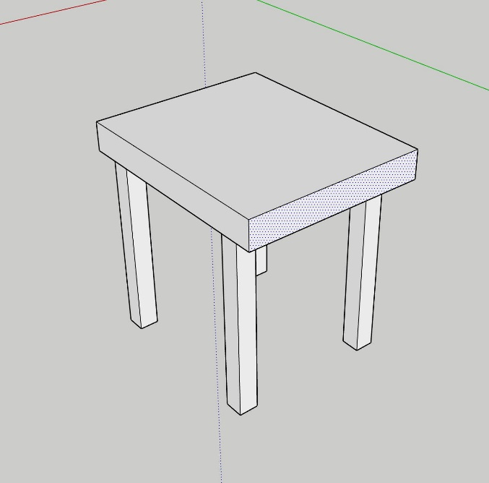
Follow the instructions on the handout to 3D model a table or a chair using Sketchup

