Slide 1
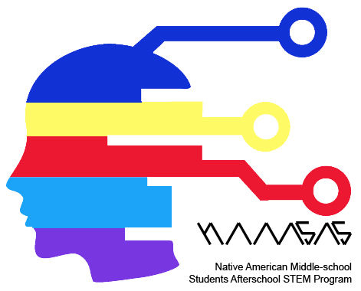
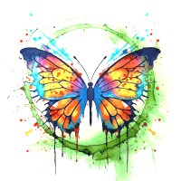
Module 04 Virtuality to Physicality: 3D printing
Notes:
1st Fire
The Journey Begins - Leaving Our Coastal Home
Responding to the prophecy, the Neshnabek began a mass migration to the west. Guided by the sacred Megis shell of the Midewewin Lodge, the people gathered at a promised turtle-shaped island (Moniyak) near present day Montreal.
The Neshnabek continued their journey, following the Megis to a resting place at Kche Nisajewen (Niagara Falls). It was here that three related but distinct groups formed, the Ojibwe, Odawa and Bodéwadmi. Joined through heritage and spirituality, each group served the Neshnabek as a whole.
the Neshnabel will follow the sacred shell the Megis...to the chosen ground (see homeland You will know..he chosen ground... when you come to a land where food grows on water. If you do not move you will be destroyed
Mshike (Turtle)
The turtle is a revered spint, playing a role in ceremonies and our creation story. Here he symbolizes the beginning and end of our migration

Slide 2
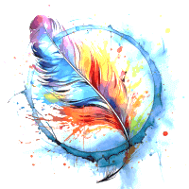
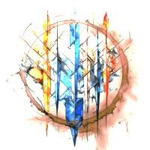
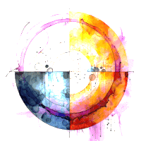
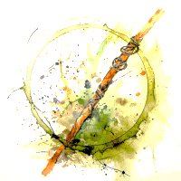
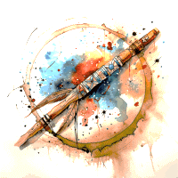

Module 03 Virtual Realization: 3D scanning and Viewing a Building in VR
3.
1.
Do not steal from one another.
Module 01 Basic Building Blocks: Sketching to Rendering
Have only one God.
2.
Module 05 Augmented Living: Using AR in Design
4.
Do not talk about each other.
Module 02 Virtuality: Using VR in Architectural Visualizations
Do not kill one another.
5.
Module 04 Virtuality to Physicality: 3D printing
Be kind to one another.
7.
Module 07 VR+AR Mini-Hackathon
Module 06 Human Centered Design: Empathy and Designing for Special Groups
Respect the peace pipe.
Do not be stingy or greedy.
6.
Notes:
1st Fire
The Journey Begins - Leaving Our Coastal Home
Responding to the prophecy, the Neshnabek began a mass migration to the west. Guided by the sacred Megis shell of the Midewewin Lodge, the people gathered at a promised turtle-shaped island (Moniyak) near present day Montreal.
The Neshnabek continued their journey, following the Megis to a resting place at Kche Nisajewen (Niagara Falls). It was here that three related but distinct groups formed, the Ojibwe, Odawa and Bodéwadmi. Joined through heritage and spirituality, each group served the Neshnabek as a whole.
the Neshnabel will follow the sacred shell the Megis...to the chosen ground (see homeland You will know..he chosen ground... when you come to a land where food grows on water. If you do not move you will be destroyed
Mshike (Turtle)
The turtle is a revered spint, playing a role in ceremonies and our creation story. Here he symbolizes the beginning and end of our migration

Slide 3
Types of Lighting
Ambient or General Lighting
Accent Lighting
Task Lighting

Slide 4

Ambient or General Lighting

Slide 5

Accent Lighting

Slide 6

Task Lighting

Slide 7


Slide 8
Electricity and Light
Snap Circuits

Slide 9

Electrical Engineers
Image Source: https://research.com/degrees/electrical-engineering-degree

Slide 10
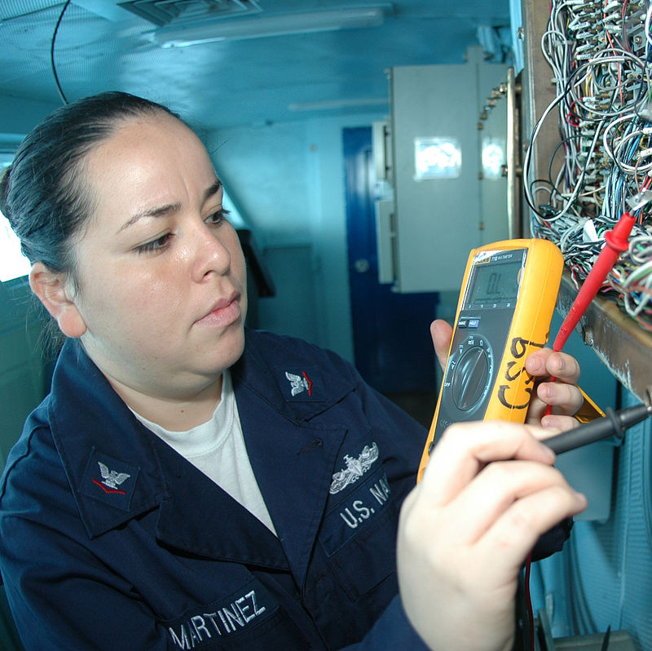
Electricians
Image Source: https://www.powerstudies.com/blog/electrical-fatalities-higher-among-hispanic-workers

Slide 11

Electronic Engineers
Image Source: https://www.swansea.ac.uk/engineering/electrical/

Slide 12
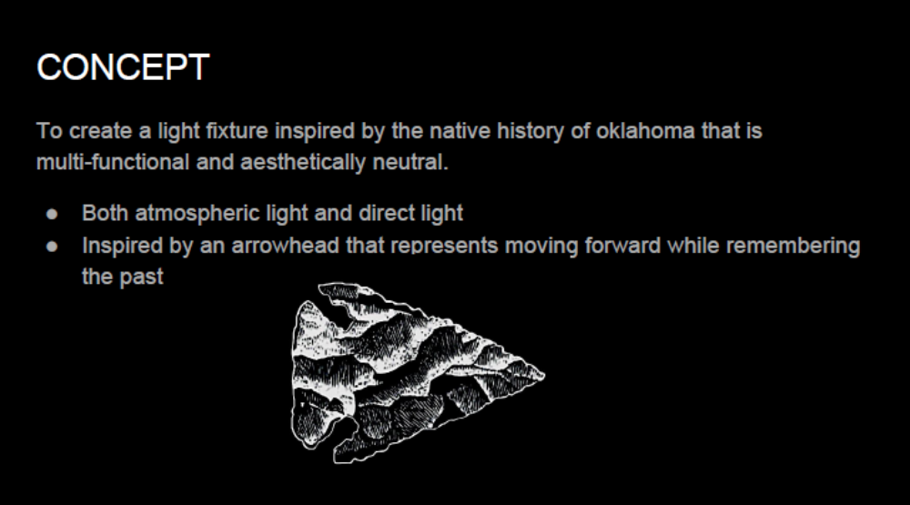

Slide 13
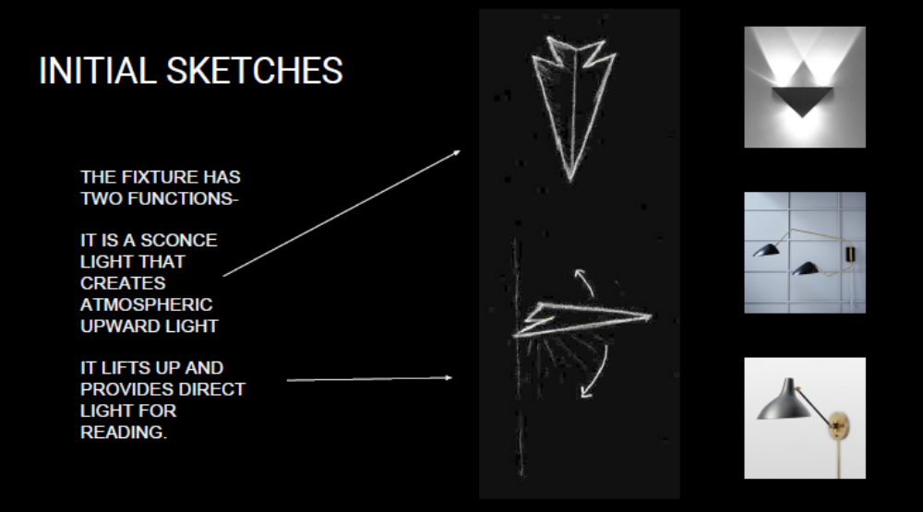

Slide 14
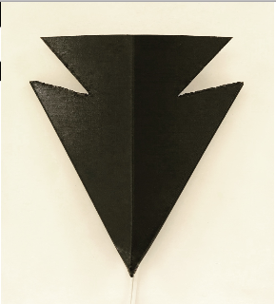
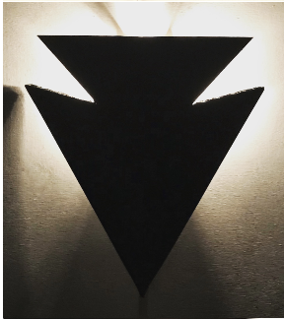
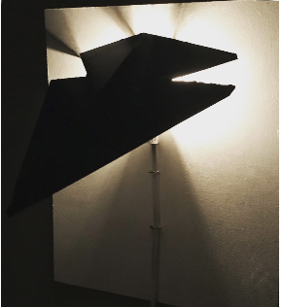

Slide 15
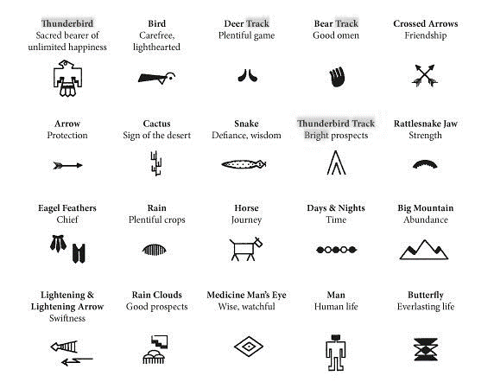

Slide 16
